Slide 1
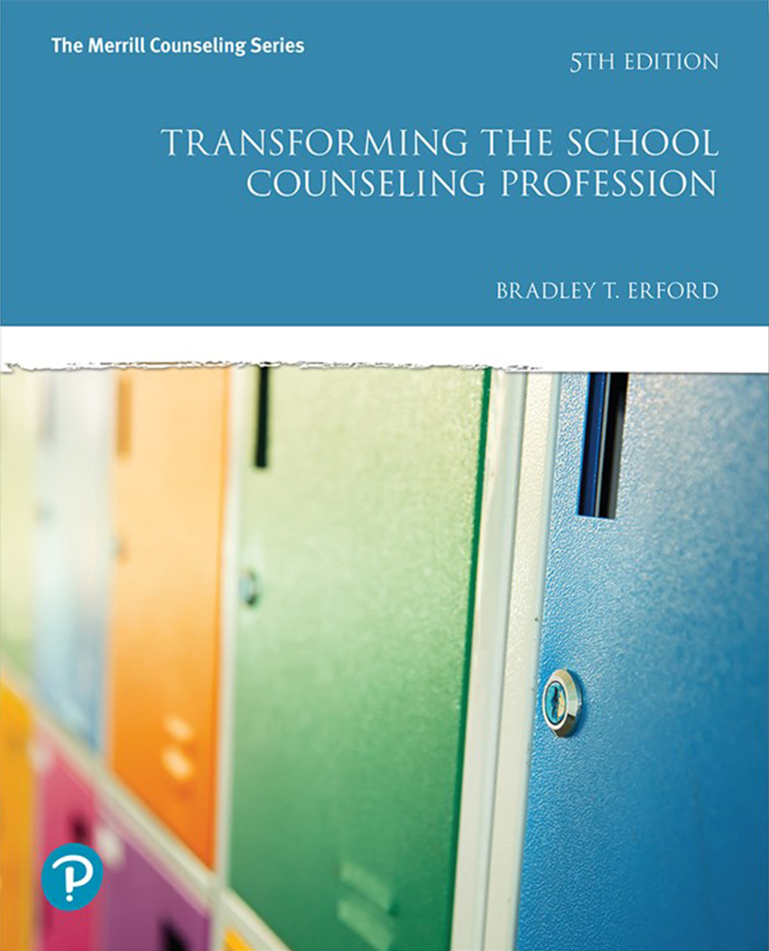
Becoming a Professional School Counselor: Current Perspectives, Historical Roots, and Future Challenges
Chapter 1
Notes:
If this PowerPoint presentation contains mathematical equations, you may need to check that your computer has the following installed:
1) MathType Plugin
2) Math Player (free versions available)
3) NVDA Reader (free versions available)

Slide 2
The Rise of Professional School Counseling in the United States
Throughout history, every society has found methods to give selected young people direction and support as they questioned who they might become.
But “guidance” and “counseling” were neither planned nor made available to all young people.
With educational reform in the late 19th century and the burgeoning Industrial Revolution, the field of school guidance and counseling was formed.

Slide 3
Pioneers in the Field of School Guidance and Counseling
George Merrill: First systematic vocational guidance program in San Francisco (1895)
Jesse B. Davis: Program of vocational and moral guidance in the schools of Grand Rapids, Michigan (1908)
Eli W. Weaver: Principal of a high school in Brooklyn, who authored Choosing a Career (1908)
Frank Parsons: Generally regarded as the primary architect of vocational guidance in the U.S.
He is also considered, the “Father of vocational guidance”

Slide 4
Vocational Guidance: Frank Parsons
In 1908, Parsons founded the Vocational Bureau of the Civic Services in Boston
In 1909, Choosing a Vocation was published.
Parson’s book laid out the principles and methods for implementing vocational guidance.
Parsons’ most famous contribution to the field is what became known as the trait and factor approach. This involves a person’s self-evaluated traits and personal needs being matched with a career.
Many leaders in American education then began to adapt to Parsons’ paradigm of vocational guidance.

Slide 5
Educational Reform
At the turn of the century, the rapidly growing industrial society called for:
Less bookish and more focused industrial education.
Bridging the gap between schooling and the realities of the adult world.
School-to-work transitions.
Adapting new educational theories for use in the schools.

Slide 6
The Role of the Professional School Counselor in the 1920s, 1930s, and 1940s
Hutson (1958) suggested that, in addition to the importance of vocational guidance as a powerful force shaping the guidance counselor’s role, there were 5 others:
Student personnel administration
Psychologists, working as researchers and clinicians
Personnel work in industry
Social work
Mental health and psychiatry

Slide 7
The Role of the Professional School Counselor in the 1920s, 1930s, and 1940S
Student Personnel Administration: Counselors became the Dean of Students in some schools. Their job was to deal with personal and disciplinary problems. They were also in charge of admissions and placement.
Psychologists: Counselors administered achievement and diagnostic tests. Also, they were responsible for providing specialized services to students experiencing learning or behavioral problems.

Slide 8
The Role of the Professional School Counselor in the 1920s, 1930s, and 1940S
Personnel Work in Industry: This involved preparatory work for entrance into personnel work in industry. It provided job requirement specifications, motivation studies, and tests for job application and vocational guidance purposes.
Social Work: While professional school counselors traditionally have been involved in community outreach, social workers became more available in schools as a community liaison. This allowed the role of the professional school counselor to become more school-bound.

Slide 9
The Role of the Professional School Counselor in the 1920s, 1930s, and 1940s
Mental Hygiene and Psychiatry: The National Association for Mental Hygiene disseminated the principles of mental health and information about various types of personality maladjustment and advocated that the development of wholesome personalities “is the most important purpose of education.”
In the 1920s and subsequent decades, psychiatry focused on combating juvenile delinquency and sought to establish “child guidance clinics” for the psychiatric study and treatment of problem children in the schools.

Slide 10
The Role of the Professional School Counselor in the 1920s, 1930s, and 1940s
Each of these influences or forces shaped perspectives on why counselors were important in schools.
Cowley (1937) reported three areas of emphasis that were evolving in the public schools, guidance as the
Personalization of education
Integration of education
Coordination of student personnel services.

Slide 11
Guidance as the Personalization of Education
This emphasized the importance of personalizing “mass education.” Cowley decried:
The growing lack of close relationships between teachers and students.
The lack of a personal touch in education.
The decreased concern on the part of administrators about student problems.
In contemporary terms, the professional counselor’s role is one in which the student is helped to achieve academic development.

Slide 12
Guidance as the Integration of Education
Cowley believed professional school counselors should help students identify talents and motivations in order to effectively sort through educational options and create a unified course of instruction.

Slide 13
Guidance as the Coordination of Student Personnel Services
Cowley suggested that counselors be given all information from other mental health workers so they could coordinate all specialist services available to students.
Therefore, the professional school counselor would be dealing not only with the specific problem of a person, but with the whole person.

Slide 14
Events Contributing to the School Counseling Field in the 1920s, 1930s, and 1940s
In 1926, New York became the first state to require certification for guidance workers.
In 1929, New York became the first state to have full-time guidance personnel in the State Department of Education.
In 1939, the first edition of the Dictionary of Occupational Titles by the U.S. Department of Labor was published.
In 1940, the U.S. Bureau of Labor Statistics was established.

Slide 15
Events Contributing to the School Counseling Field in the 1920s, 1930s, and 1940s
In 1933, the Wagner-Peyser Act established the U.S. Employment Service.
In 1938, a Guidance and Personnel Branch was created in the Division of Vocational Education in the U.S. Office of Education.
In 1942, Carl Rogers published Counseling and Psychotherapy.
In 1948, the Occupational Outlook Handbook was first published by the U.S. Bureau of Labor Statistics.

Slide 16
School Counseling Comes into its Own: The 1950s and 1960s
The American School Counselor Association (A S C A) was founded in 1952.
The American Personnel and Guidance Association (A P G A; now known as the American Counseling Association [A C A]) was formed in 1952 by the merger of the:
National Vocational Guidance Association
American College Personnel Association
National Association of Guidance Supervisors and Counselor Trainers
Student Personnel Association for Teacher Education
In 1953, School Counselor was created as the professional journal of A S C A.

Slide 17
School Counseling Comes into its Own: The 1950s and 1960s
In 1953, the Pupil Personnel Services Organization of the Division of State and Local School Systems was created in the U.S. Office of Education.
In 1957, the A P G A created the American Board for Professional Standards in Vocational Guidance.
In 1959, the National Association of Guidance Supervisors and Counselor Trainers took on a five year project to outline standards for education in the preparation of secondary school counselors.
In 1959, James B. Conant, the former president of Harvard, wrote The American High School Today, an influential analysis of the need for strengthened secondary school education.

Slide 18
The National Defense Education Act, 1958-1968
The National Defense Education Act (N D E A) identified professional school counselors as sociopolitical instruments to achieve national goals.
The impetus for this legislation was the launch of Sputnik in 1957 by the Soviet Union.
To ensure the United States’ competitiveness in the “space race,” counselors began to test students and encourage high achieving students to go into the “hard sciences.”

Slide 19
The Effects of the N D E A
Title V of the N D E A provided funds for:
School systems to hire and provide resources (e.g., tests, occupational and educational materials) to secondary school counselors.
Reeducating existing secondary school counselors.
Universities to prepare professional school counselors in full-time, year-long guidance and counseling institutes.
Offering more specialized programs (e.g., precollege guidance) in summer guidance and counseling institutes.
By the end of the 1960s professional school counselors were vital in achieving the multiple missions in schools (e.g., dropout prevention, academic scheduling, educational and career guidance, crisis intervention).

Slide 20
The Great Society Legislation of the 1960s
The Elementary and Secondary Education Act (E S E A) of 1965 designated funds for guidance and counseling.
The Vocational Education Act Amendments of 1968 advocated for:
Career guidance programs.
Responses to people who were disadvantaged and people with disabilities.
The expansion of a broadened concept of guidance and counseling, including its extension into the elementary schools.

Slide 21
The Years of Consolidation and Refinement: The 1970s and Beyond
Much of the legislation in the 1970s focused on vocational education and career education.
Career Education Incentive Act of 1976
The educational amendments—the E S E A—of 1976 included major support for:
Guidance and counseling in schools.
A major emphasis on vocational guidance in schools
Implementation of an administrative unit in the U.S. Office of Education.
A large amount of theory building took place, leading to the development of materials on decision making, career education, drug abuse prevention, and self-development.

Slide 22
Multicultural Diversity
Federal legislation in the 1960s banned segregated schools.
School counselors were given responsibility to develop plans of action and to work with culturally diverse groups of students in classrooms, group counseling, and in other settings.
However, there was a lack of attention to issues of cultural diversity in counseling theory and practice.
During the ensuing decades, growing attention has been directed to embedding scholarship about ethnic and racial differences into counseling theory and practice.
These perspectives provide affirmations of the worldviews of different cultural groups and the implications of these for counseling process.

Slide 23
Population
Today’s world is growing ever smaller, thanks to modern advances in technology, as well as the diversity that continues to add to the depth of our communities and bring types of people who rarely interacted previously into the same sphere.
As professional school counselors, it is imperative that we understand our stakeholders and their perspectives in order to understand how to help them most effectively.
It is important to consider changes in a school’s population, including:
Structural changes
Socioeconomic changes
Family changes

Slide 24
The Latter Decades of the 20th Century
During the 1980s and into the 1990s, much of the legislative activity focused on the need for professional school counselors to deal with child abuse, drug abuse prevention, and drop-out prevention. There was also an emphasis on career guidance.
Carl D. Perkins Vocational Education Act of 1984/Carl D. Perkins Vocational and Applied Technology Act of 1990: These acts were the major federal sources of funding for guidance and counseling in schools.
School to Work Opportunities Act: This Act reinforced the importance of career guidance as students make the transition from school to employment.

Slide 25
The Latter Decades of the 20th Century
In 2003, the National Career Development Guidelines Project was commissioned by the U.S. Department of Education’s Office of Vocational and Adult Education.
In 2005, they created a website for counselors including new guidelines aligned with the No Child Left Behind Act (N C L B) and learning activities and strategies for K-12 students, teachers, and parents.
The Elementary School Counseling Demonstration Act (1995) was the first major legislative departure from the emphasis on career guidance.
This act provided $20 million to assist schools in making counseling services more accessible and in creating a more positive ratio of professional school counselors to students.

Slide 26
The Latter Decades of the 20th Century
The Elementary and Secondary School Counseling Program is a U S D E discretionary program to provide competitive grants to school districts that demonstrate:
The greatest need for new or additional counseling services.
The greatest potential for replication or dissemination or that propose the most innovative program.
The more wide-ranging affirmation of the need for professional school counselors is embedded in No Child Left Behind, signed into law in January 2002.

Slide 27
The Latter Decades of the 20th Century
The need for and support of school counseling is evident in N C L B relating to:
Dropout prevention
Career counseling
Drug and alcohol counseling
Safe and drug-free schools
Facilitation of the transition of students from correctional institutions back to community schools
Identification of and services for gifted and talented students
Children who are neglected or delinquent or otherwise at risk of academic failure

Slide 28
Continuing and Future Issues for the School Counseling Profession
To clarify the expected results or outcomes of guidance and counseling programs in the schools, A S C A published The National Standards for School Counseling Programs in 1997.
In 2014, A S C A revised these standards in the A S C A Mindsets and Behaviors publication.
These standards argued that school counseling programs should facilitate three broad areas of student development:
Academic development
Career development
Social-emotional development

Slide 29
Continuing and Future Issues for the School Counseling Profession
The National Career Development Guidelines also address 3 broad areas of student development:
Personal/social development
Educational achievement and lifelong learning
Career management
In 2010, the National Governors Association and the Council of Chief State School Officers introduced the Common Core State Standards.
These standards set high quality expectations for all students in the areas of math and language arts to prepare graduates to compete in the global economy.

Slide 30
Continuing and Future Issues for the School Counseling Profession
Herr (1998) has suggested that the future role of professional school counselors is based on 10 pivotal concerns:
The degree to which school counseling programs are systematically planned; tailored to the priorities, demographics, and characteristics of a particular school district or building; and clearly defined in terms of the results to be achieved rather than the services to be offered.
The degree to which school counseling programs [that] begin in the elementary school or in the secondary school [are] truly . . . longitudinal (K to 12) and systematically planned.
The degree to which school counseling programs are seen as responsible for the guidance of all students or for only some subpopulations of students, such as those at risk.

Slide 31
Continuing and Future Issues for the School Counseling Profession
The degree to which school counseling programs include teachers, other mental health specialists, community resources, parent volunteers, and families as part of the delivery system.
The degree to which school counseling programs are focused on precollege guidance and counseling; counseling in and for vocational education and the school-to-work transition; counseling for academic achievement; and counseling for students with special problems.
The degree to which professional school counselors should be generalists or specialists; members of teams or independent practitioners; and proactive or reactive.

Slide 32
Continuing and Future Issues for the School Counseling Profession
The degree to which professional school counselors employ psychoeducational models or guidance curricula as well as individual forms of intervention to achieve goals.
The degree to which the roles of professional school counselors can be sharpened and expanded while not holding counselors responsible for so many expectations that their effectiveness is diminished and the outcomes they affect are vague.
The degree to which professional school counselors have a reasonable student load, 250 or less.
The degree to which professional school counselors effectively communicate their goals and results to policy makers and the media.

Slide 33
Traditional and Emerging Practices
Realizations Guiding the Transformation of the Professional School Counselor’s Role:
Professional school counselors receive the most extensive specialized training in consultation, collaboration and team relationship building.
Professional school counselors can’t do it all! Caseloads are increasing as are serious psychological problems among students. Counselors should take the initiative, then partner with students, teachers, and community organizations for support.

Slide 34
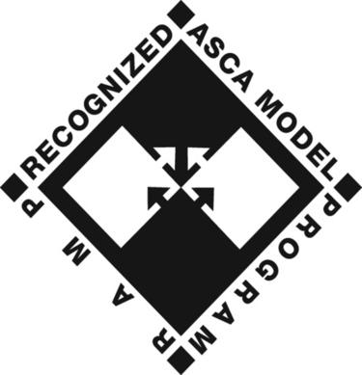
Traditional and Emerging Practices
Well-organized and well-run, evidence-based, comprehensive developmental school counseling programs are greatly needed in today’s schools and do work.
Since all professional school counselors have strengths and weaknesses, they may all provide varying quality levels of service to varying populations.
Many students are not getting what they need from our educational and mental health systems.

Slide 35
Traditional and Emerging Practices
Roles of the Professional School Counselor:
Provider of Individual and Group Counseling Services: School counselors are the mental health experts in the school, and they provide interventions at the individual, group, and school-wide levels.
Professional: School counselors are representatives of the profession, ethical practitioners, aware of the history and future of the profession, and maintain membership in professional organizations.
Agent of Diversity and Multicultural Sensitivity: The multicultural counseling movement is helping professional school counselors lead the way toward a more diverse, tolerant, and sensitive educational environment.

Slide 36
Traditional and Emerging Practices
Roles of the Professional School Counselor: [continued]
Leader and Advocate for Academic and Social Justice: Counselors have an ethical responsibility to help students minimize or eliminate barriers to educational performance and career and personal-social development.
Developmental Classroom Specialist Delivering the School Counseling Core Curriculum: As part of a comprehensive developmental guidance program, counselors prepare, provide, and evaluate instruction in the classroom.

Slide 37
Traditional and Emerging Practices
Roles of the Professional School Counselor: [continued]
Career Development and Educational Planning Specialist: School reform and accountability movements require school counselors to focus on academic performance and achievement.
School and Community Agency Consultation/Collaboration Specialist: School counselors work hand-in-hand with parents, individuals, and organizations.
School Reform and Accountability Expert: Outcomes research and results evaluation of school counseling services and activities help determine the program’s effectiveness.

Slide 38
Traditional and Emerging Practices
Roles of the Professional School Counselor: [continued]
Safe Schools, Violence Prevention, At-Risk Specialist: With conflict and violence on the rise in today’s schools, developmental and intervention components of the school counseling’s program need to address these issues.
Advocate for Students with Special Needs: School counselors are sometimes the lone advocates for children with special needs and are responsible for finding the right avenues to serve this population.

Slide 39
Living the Transformed Role
The question becomes not whether the role of the professional school counselor will continue its transformation, but what shape this transformation will involve.
Systemic interventions are essential to ensure that the needs of all children in our society are addressed.

