Slide 1
The ASCA National Model: Developing a Comprehensive, Developmental School Counseling Program
CHAPTER 2

Slide 2
The ASCA Mindsets and Behaviors and National Model
In 1997, the American School Counselor Association (A S C A) published The National Standards for School Counseling Programs to provide a standardized basis for the creation of comprehensive, developmental, and preventive school counseling services.
In 2014, A S C A published the Mindsets and Behaviors based on research from the University of Chicago on noncognitive factors influencing learning.
The 35 standards apply to the academic, career, and social/emotional domains.
The standards also are further organized into a mindset standards category and a behavior standards category subdivided into learning strategies, self-management skills, and social skills.

Slide 3
The ASCA Mindsets and Behaviors and National Model
The Mindsets and Behaviors also are further organized into
Mindset standards category: 6 standards; personal belief system
Behavior standards category:
Learning strategies: 10 standards; tactics used when learning or thinking
Self-management skills: 10 standards; persistence, avoidance, and organizational skills
Social skills: 9 standards; social interaction skills
Although these can be implemented through nearly any component of the school counseling program, many professional school counselors today implement much of this developmental model through:
Developmental classroom guidance lessons.
Responsive services.

Slide 4
The ASCA Mindsets and Behaviors and National Model
To expand on and integrate the ASCA National Standards into a comprehensive framework that addressed the “how” of school counseling, ASCA published ASCA National Model: A Framework for School Counseling Programs (now in its 3rd edition).
Professional school counselors were encouraged to switch from the traditional focus on services for some select needy students to program-centered services for every student in the school and, by extension, for their families and community.

Slide 5
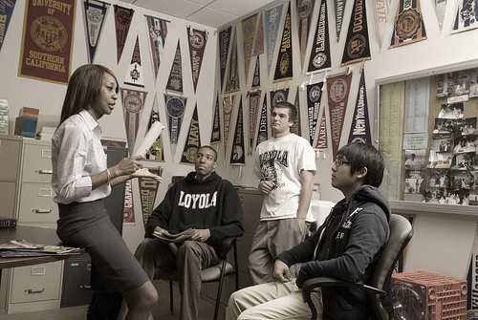
The ASCA Mindsets and Behaviors and National Model
The ASCA National Model focused professional school counselors on a more comprehensive, systemic approach to four core elements or mechanisms for student success:
Foundation
Delivery
Management
Accountability
The model’s four infused themes include:
Leadership
Advocacy
Systemic change
Collaboration and teaming

Slide 6
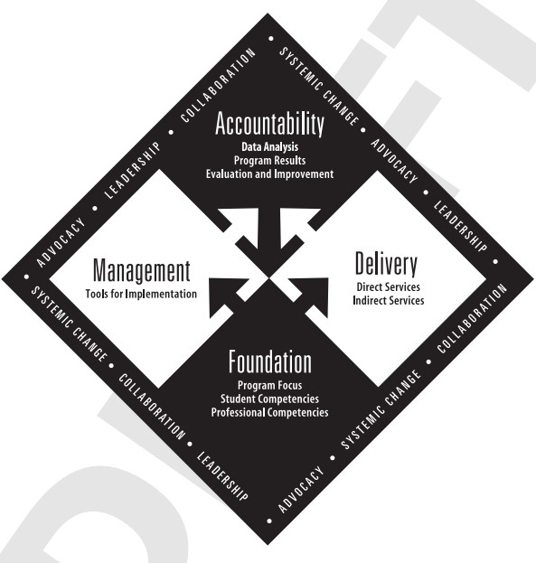
THE ASCA NATIONAL MODEL

Slide 7
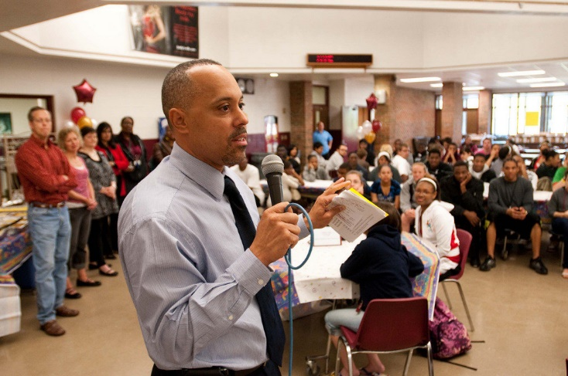
Themes of the A S C A National Model
Leadership describes the activities of professional school counselors within the school and beyond to enact systemwide changes to facilitate student success.
Ensure that all students have access to rigorous academic programs.
Close achievement and opportunity gaps among student groups, particularly minorities and the materially poor.

Slide 8
Themes of the ASCA National Model
Advocacy involves the systematic identification of student needs and accompanying efforts to ensure that those needs are met.
Professional school counselors help every student to achieve academic success by:
Setting high expectations.
Providing needed support.
Removing systemic barriers to success.

Slide 9
Themes of the A S C A National Model
Collaboration requires that professional school counselors work with a wide array of stakeholders within the school, school system, and community.
Collaborative efforts should focus on:
Providing students access to rigorous academic programs.
Other factors leading to academic success.
Teaming with parents, educators, and community agencies.

Slide 10
Themes of the A S C A National Model
Systemic change encompasses schoolwide changes in expectations, instructional practices, support services, and philosophy with the goal of raising achievement levels and creating opportunity and access for all students.
A focus on data-driven and evidence-based programming allows professional school counselors to identify areas in need of improvement.
This leads to alterations in systemic policies and procedures that empower students and lead to higher performance and greater opportunities for postsecondary success.

Slide 11
Primary Program Components of the National Model
The 4 primary program components of the National Model are:
Foundation
Delivery
Management
Accountability

Slide 12
Foundation
The program foundation, the “what” of a comprehensive school counseling program, makes clear what every student will know and be able to do.
Includes emphases on the school counseling program’s vision statement that stems from a school counselor’s beliefs and philosophies, mission, student competencies, and professional competencies.
Through teamwork and collaboration among stakeholders, counselors help construct a vision statement (based on principles and beliefs) that will guide the program.
The purpose and vision of a program are then operationalized through development of a program mission statement and program goals.

Slide 13
Delivery
Delivery is the “how” of the comprehensive, developmental school counseling program, and includes direct and indirect student services.
Direct services are frequently targeted to students and include attention to the school counseling core curriculum, individual student planning, and responsive services.
Systematic, developmental classroom lessons
Parent workshops
Individual or small-group counseling
Crisis response
Indirect services support direct services and are the foundation of a system-focused school counseling program and include referrals, consultation, and collaboration.

Slide 14
Delivery: School Counseling Core Curriculum
The school counseling core curriculum provides services to large, usually classroom-sized groups. Examples include:
Classroom instruction and activities (units)
Parent workshops
Peer helper programs
Classroom instructional units are not independent; they may be linked to classroom units at other grade levels and/or integrated into the school’s core curriculum.
Scope and sequence across grade levels is an important consideration.
An advantage of classroom guidance is that it enables service delivery to a large number of individuals that addresses topics in a preventive manner.

Slide 15
Delivery: Individual Student Planning
Individual student planning addresses the need for all students to plan and monitor their academic progress.
Individual or small-group appraisal includes using test information and other student data to help develop goals and plans.
The comprehensive school counseling program offers an integrated and holistic method for students to assess and become knowledgeable about their abilities, interests, skills, and achievement.
During individual advisement, the professional school counselor helps students plan for and realize their goals.

Slide 16
Delivery: Responsive Services
Responsive services include both direct and indirect services, and address both proactive and reactive goals.
Methods of direct service delivery for responsive services include:
Individual counseling
Small-group counseling
Crisis response
Methods of indirect service delivery for responsive services include:
Consultation and collaboration
Referral

Slide 17
Delivery: Responsive Services
Individual counseling sessions meet both proactive and reactive student needs.
The perspective on individual counseling promoted by the “new vision” of school counseling is that, if professional school counselors spend too much time with a few students, they will be perceived as “therapists” and probably shortchange most of the student body.
A large proportion of a professional school counselor’s day needs to be spent outside of or beyond the school counseling office.

Slide 18
Delivery: Responsive Services
Small-group counseling responds both proactively and reactively to student needs.
Group counseling and psychoeducational counseling services offer a variety of small-group experiences on relevant topics or issues such as study skills, effective relationships, bereavement, and postsecondary planning.
Student insight and/or learning can come from group leaders, other group members, and/or the synergy of the group.
Group counseling allows school counselors to address issues common to several students at one time, which makes it a time- and cost-efficient method of service delivery.

Slide 19
Delivery: Responsive Services
Crisis response to critical and acute situations that require immediate intervention is an important counselor function.
Crisis situations usually call for such immediate intervention because of their sudden onset.
Crisis counseling interventions include individual counseling, group counseling, and/or the managing and coordinating of the services of others.
The purpose of crisis response interventions is to diffuse a situation, serve school community members affected by the situation, and initiate a healing process.
Professional school counselors may lead or contribute to a committee review and update of the school’s crisis response plan to ensure it is current and accurate.

Slide 20
Delivery: Responsive Services
Consultation and collaboration are indirect responsive services in which professional school counselors consult and collaborate with administrators, teachers, or parents to help them with student issues or concerns.
Consultation is a process of directly working with a second party (the consultee) to indirectly help a third party (the student).
Steps of the consultation process include:
Identify a purpose.
Establish a goal.
Plan strategies to meet that goal.
Assign responsibilities to carry out that goal.

Slide 21
Delivery: Responsive Services
Referral enlists the services of other professionals to assist school counselors.
Many students today are confronted with complex issues compounded by family, peer pressure, developmental, and societal situations.
It is not practical for professional school counselors to be the sole service provider for these students.
Professional school counselors enlist the services of other school personnel (e.g., school psychologist, school nurse, school social worker) and/or community agency personnel to address some student issues.

Slide 22
Management
The management system element accounts for the “when,” “why,” and “on what authority” of a comprehensive school counseling program. It comprises:
School counselor competencies assessments
School counseling program assessments
Use of time assessments
Annual agreements
Advisory council
Use of data
Annual results data (e.g., process, perceptions, and outcome data)
Action plans
Lesson plans
School counseling program calendar

Slide 23
Management
Annual agreements are meant to help both professional school counselors and administrators to understand the goals of a school counseling program and to remove barriers to its effective implementation.
These agreements are short and to the point, but they represent a basic understanding of responsibilities and program management.

Slide 24
Management
Advisory councils provide a mechanism for input, feedback, and evaluation of the school counseling program’s activities for a wide range of individuals.
The school counseling program advisory committee (SCPAC) serves as a sounding board and steering committee and should include:
Principal
Professional school counselor(s)
Several influential teachers and parents
Influential school resource person (e.g., school psychologist, reading specialist)
The SCPAC should convene at least twice annually—and more frequently if the program is new or undergoing major changes.

Slide 25
Management
Use of Data
Professional school counselors monitor student progress and collect and disaggregate data to identify systemic issues that interfere with equity in achievement.
Action plans are detailed strategies for achieving important outcomes. They include:
Goals to be addressed
Domain(s), standard(s), and competencies
Description of school counseling activities and title of curriculum
Timeline and name of person(s) responsible for each activity
Methods of evaluating student success
Expected result for students
Lesson plans are used to implement developmental, psychoeducational lessons in the classroom.

Slide 26
Management
Professional school counselors are strongly encouraged to produce weekly, monthly, and annual calendars.
Annual calendars should contain classroom lessons, back-to-school night, open house, meetings, standardized test dates, career or college nights, and school evening activities.
Weekly calendars should contain classroom lessons, group and individual counseling, meetings with students, collaboration and advocacy, and data analysis.

Slide 27
Management: Assessments
Annually, professional school counselors should assess:
Their professional competencies.
The implementation of the school
counseling program.
How they are using their time.
ASCA recommends that professional school counselors should spend at least 80% of their time in direct service activities.

Slide 28
Accountability System
Accountability answers the all-important question of “How are students different as a result of the program?”
Program results comprise outcomes assessments that document changes in students through systematic analysis of their performance within various program components.
Performance appraisal includes all local job and program expectations that help to assess one’s skill in implementing a comprehensive, developmental school counseling program.
Program assessment analyses are conducted to ensure that a school’s program aligns with some set of standards, whether at the local or state level, or with the A S C A National Model.
Data analysis involves analysis of student achievement data and use-of-time (service) assessments.

Slide 29
Roles of Other School Personnel in the Comprehensive School Counseling Program
The counselor is but one player in a team effort.
Teachers:
Can serve as valuable allies, as well as referral sources for children in need of counseling services.
Must be properly prepared and motivated to help students meet the school counseling program’s competencies.
Failure to establish positive working relationships with teachers can affect access to that teachers’ students and limit a counselor’s ability to implement the classroom guidance curriculum.

Slide 30
Roles of Other School Personnel in the Comprehensive School Counseling Program
Resource Teachers:
Possess special expertise that make them invaluable consultants and referral sources.
Connecting with these teachers ensures that all students receive comprehensive school counseling services.
Principals and Assistant Principals:
Contribute to many important facets of the comprehensive school counseling program, such as facilitating needs assessments and program evaluations.
Defend the counselor from role diffusion and non-counseling tasks.

Slide 31
Roles of Other School Personnel in the Comprehensive School Counseling Program
School Psychologists:
Specially trained to provide psychological services in a school environment.
Role includes consultation with parents and school personnel, case management of special-needs children, and counseling with severely behavior-disordered or emotionally disturbed students.
School Social Workers (Visiting Teachers, Pupil Personnel Workers):
Conduct sociological assessments for child study proceedings and work with needy families to secure social, financial, and medical services.
Valuable sources of information on families and communities.
Serve as liaisons between the school and public health facilities.

Slide 32
Roles of Other School Personnel in the Comprehensive School Counseling Program
School Nurses:
A valuable ally to school counselors on developmental matters (i.e., hygiene, personal safety, and physical and sexual development).
Can serve as referral and information sources.
Secretaries (Administrative Assistants):
Often among the first to encounter parents and students in crisis.
The manner in which secretaries respond to situations speaks volumes about the school climate.

Slide 33
Summary
The Mindsets and Behaviors provide a guide for implementing curricular goals and competencies across the domains of student academic, career, and social/emotional development.
The National Model provides a framework for describing, implementing, and evaluating a comprehensive developmental school counseling program.
Professional school counselors must work in partnership with stakeholders and other school personnel to help facilitate and smoothly implement the comprehensive school counseling program.

