Slide 1
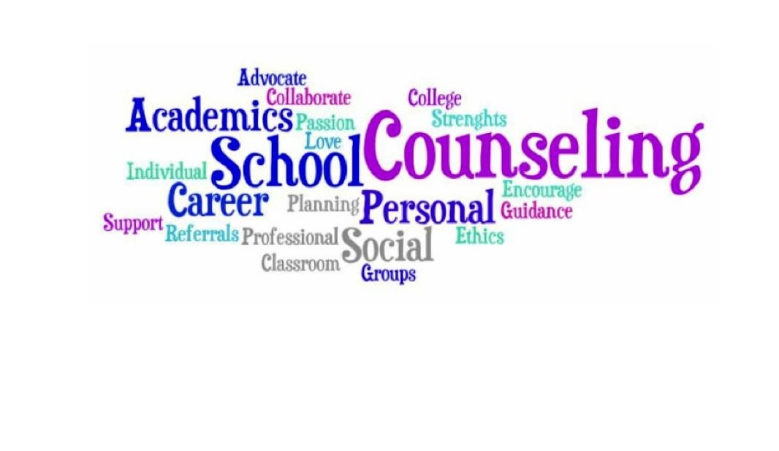
Transformational Thinking in Today’s Schools
CHAPTER 3

Slide 2


School: The Primary Workplace for School Counselors
Professional school counseling must evolve into a model that will both fit the needs of the students in this rapidly changing society and conform to the demands of school reform and accountability mandates, as well as workforce demands.
Professional school counselors must develop and/or increase their capacity to work as leaders and advocates in schools to remove barriers to student success.

Slide 3

The Context of Professional School Counseling
School counseling is one component of a complex education system that is being held accountable for educating today’s students to a higher level of academic proficiency than ever before.
School counselor education must provide an understanding of the new mission of schools, how schools function, and the school counselor’s accountability for helping schools achieve the mission.
  There must be an intentional focus on equitable outcomes and future postsecondary options for all students, especially underserved student populations.

Slide 4
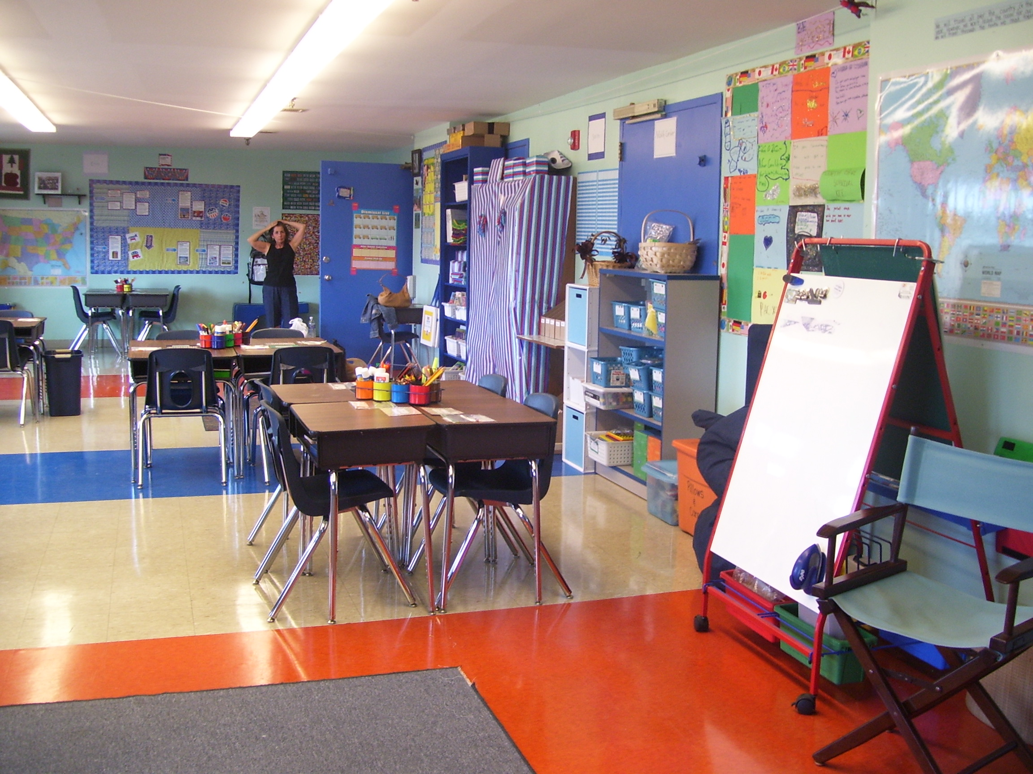
Four Forces Driving Change in Schools
Inequities in the educational system
Changes in the nation’s demographics and school populations
Changes in the economy and the workplace
Major changes in education public policy

Slide 5
Inequities in the Educational System
In the 1980s, a report titled A Nation At Risk concluded that the education system in the United States lagged behind those of other industrialized nations in meeting world-class educational standards.
  The report found that the United States’ educational system lacked a set of coherent academic content standards to define what all students should know and be able to do as a result of their 12 years of public education.
  The report recommended strengthening the high school core curriculum, stricter graduation requirements, and strengthening science instruction and teacher education.

Slide 6

Inequities in the Educational System
Subsequent to A Nation at Risk, a group of policy makers issued a report highlighting the systemic barriers that contribute to:
  The poor/under achievement of students of color and students from low-income families.
  The achievement gap that exists between these students and their more affluent peers.
The educational system systematically and consistently provides less to students who have the greatest educational needs.
  The educational system operating in this manner is an inherently inequitable state of affairs that professional school counselors must address.

Slide 7

Inequities in the Educational System
The achievement gap among students exists primarily because schools serving poor students and large numbers of students of color consistently:
  Expect and demand less in the way of academic performance.
  Provide these same students with a watered-down, weak curriculum that lacks academic content rigor.
  Assign inexperienced and the least-qualified teachers to students who have the most serious academic need.
  Provide fewer material resources to students who have the greatest needs.

Slide 8
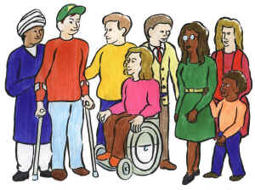
Changes in the Nation’s Demographics and School Populations
Communities are changing as a result of immigration, declining birth rates among some populations, and the general aging of the population.
To maintain the nation’s status as a world power and to protect and maintain the democratic way of life, the education system must educate all of its citizens.
  Resources must be distributed equitably, based on student need (i.e., those who need more should get more) if we are to meet the mandate of education for all students to higher levels of academic proficiency.

Slide 9

Changes in the Economy and the Workplace
The global economy, technological advances, and the explosion of knowledge in science and related fields have resulted in major changes in the workplace, the way we work, and the requirements for success in the workplace.
  All students need to be provided with the opportunity to master challenging academic content to participate successfully in the local and global economy.

Slide 10

Changes in the Economy and the Workplace
There have been significant increases in the skills and knowledge required for success at all levels in the 21st century workplace—from entry-level to professional jobs.
The academic performance of U.S. students is being surpassed by the students in industrialized competitor countries.
  Students in the United States consistently score lower on international assessments of mathematics and science than many students in other industrialized and even some non-industrialized nations.

Slide 11

Major Changes in Education Public Policy
The 1994 reauthorization of the Elementary and Secondary Education Act (E S E A)—also known as the Improving America’s Schools Act—brought a sea change to the educational landscape.
  The E S E A required all schools to educate students from low-income families according to the same challenging academic content standards used by all other schools.
  The E S E A instituted another deep policy change, a change from a focus on inputs to measuring success.
  All states, districts, and schools receiving federal support from Title 1 of the E S E A are accountable for the academic results of all students—both what students learned and their progress toward meeting proficiency levels on state standards.

Slide 12
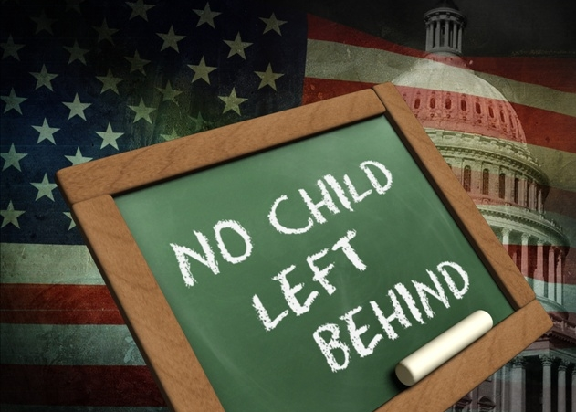
Major Changes in Education Public Policy
As required by law, the E S E A was reauthorized in 2000 and came to be known as the No Child Left Behind (N C L B) Act.
  It strengthened the accountability provisions of the original law because the requirements were being ignored for the most part by states and districts.
  N C L B, among other changes, requires states to set time lines for closing achievement gaps and to set a 12-year time frame for getting all students to proficiency.
  These accountability policies affect all of the professionals in the education system.

Slide 13

Education Reform: The College and Career Readiness Policy and School Reform
The policy to promote college-level learning for all students is a response to the changes in the demographic and economic landscape.
The National Governors Association (N G A) declared high school reform in America a highest priority.
  Partly as a result of this attention, most states have increased their graduation requirements and are requiring students to complete a rigorous curriculum in the core courses of mathematics, science, English/language arts, and foreign language.

Slide 14

Education Reform: The College and Career Readiness Policy and School Reform
By 2010, the Common Core State Standards Initiative became the driver of the national movement toward preparing all students to graduate from high school being college and career ready.
  The standards made clear what K–12 students are expected to learn and what teachers should teach at each grade level.
The last major policy for review in this process is the 2015 update and replacement of N C L B with the new law, Every Student Succeeds Act (E S S A).

Slide 15
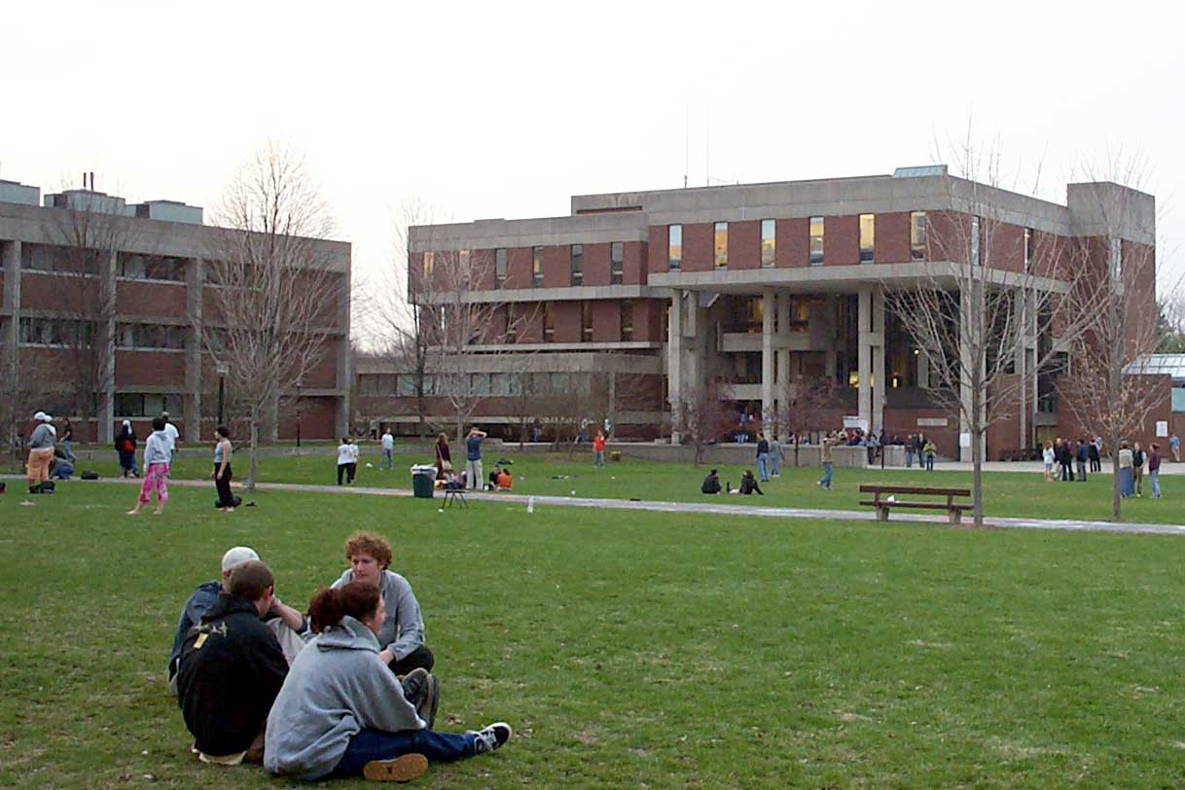
Education Reform: The College and Career Readiness Policy and School Reform
Key elements of the new law (ESSA) include:
  State-adopted standards aligned with postsecondary education and work.
  State-wide annual assessments aligned with standards.
  Accountability systems that must show progress for all groups of students.
  Public reporting of academic outcomes and opportunities to learn.
  Resources to support teachers.
  Reporting rates that low-income students and students of color are assigned to ineffective, out of field, or inexperienced teachers.
  Continued federal targeted funding for the highest poverty schools and districts.

Slide 16

Policies That Promote College-Level Rigor for All Students Drive Changes in School Counselor Practice
As is so often the case in the initiation of sweeping education reforms, there is a lag between policy adoption and successful implementation.
Expecting all students to achieve at proficient levels makes obsolete the long-standing practice by school systems and counselors of sorting students into college-bound and non-college-bound categories.
  All students are now to be educated to academic levels that would prepare them to make the choice to enter post-secondary training without the need for remediation – and succeed.

Slide 17

Policies That Promote College-Level Rigor for All Students Drive Changes in School Counselor Practice
Professional school counselors need to help develop and implement institutional policies to ensure that all students have access to the challenging curriculum required by the new law.
The transformed school counselor, while addressing the needs of individual students, will have an eye on the institutional policies and practices that impede student progress.

Slide 18
School Reforms Prompt the Transforming School Counseling Movement
Because of the many changes in schools and the world, all educational professionals must be involved in educating children for a new global economy.
The stage was set for changes in school counseling that brought the profession from a position of ancillary support to one of leadership and advocacy, supporting school success for all students.
  The Education Trust, the American School Counselor Association (A S C A), and the College Board stepped forward with actions that were far reaching and are still pivotal in guiding the transformation of the profession.

Slide 19
The Transforming School Counseling Initiative – The Education Trust
The forces pushing for change in education and the resulting revisions in education policies provided the impetus for the Transforming School Counseling Initiative (TSCI).
  The Initiative was built on the premise that school counseling, as a profession, had to move from a focus on primarily fixing individual students to removing the systemic barriers to student success for whole groups of students.

Slide 20
The Transforming School Counseling Initiative – The Education Trust
The new vision for school counseling that was developed and distributed by the Education Trust Inc through the TSCI emphasized changes that would align the school counselors’ role with new educational changes and mandates for educators in schools.
  It highlighted movement of the professional school counselor from engaging in traditional practice to being a proactive change agent and advocate who focuses on supporting and creating pathways that allow all students to have school success.
  Teaming, collaboration, advocacy, leadership, and use of data to effect change are the linchpins for the TSCI’s structured changes in the way professional school counselors should be trained.

Slide 21
National Standards for School Counseling Programs
In 1997, the A S C A published the National Standards for School Counseling Programs consisting of nine standards, three each in the domains of academic, career, and personal/social development.
  The National Standards provided a standardized basis for the creation of comprehensive, developmental guidance programs.
  They gave direction to a profession searching for ways to solidify an identity and role in standards-based school reform.
  They provided professional school counselors in districts across the nation with a common set of expectations for each of the three A S C A domains.
The National Standards became unifying elements that helped professional school counselors find ways to respond affirmatively that school counseling was a discipline with standards that resembled those of other content disciplines (e.g., math, science, social studies).

Slide 22
The ASCA National Model: A Framework for School Counseling Programs
Subsequent to publishing the National Standards, the A S C A developed and published the A S C A National Model: A Framework for School Counseling Programs.
  The model addressed elements of program foundation, delivery, management, and accountability.
  The A S C A incorporated into the framework of its model the themes of leadership, advocacy, collaboration, and systemic change, themes that were foundational to the work of the T S C I at the Education Trust.

Slide 23
The Reach Higher Initiative
In 2015, Michelle Obama included the words “supporting high school counselors who can help more kids get into college” as the fourth statement in describing the Reach Higher Initiative.
  This affirmation of school counseling highlighted the importance of the work of school counselors in reaching the President’s national goal.
  This opportunity positioned school counseling leaders in a role of providing expert advisement to White House Reach Higher staff.
  This work gave birth to a new national professional organization, The National Consortium for School Counseling and Postsecondary Success.

Slide 24
The Reach Higher Initiative
The Reach Higher initiative will help make sure all students understand what they need to do to complete their education.
The initiatives include:
  Exposing students to college and career opportunities.
  Understanding financial aid eligibility that can make college affordability a reality.
  Encouraging academic planning and summer learning opportunities.
  Supporting high school counselors who can help more kids get into college.

Slide 25
Impact of Change on School Counselor Practice: Accountability in School Counselor Practice
Accountability, measurable evidence of a positive impact on student academic success, is a critical driver for school reform with far-reaching implications for school counseling practice.
  With significant emphasis in school reform being put on outcomes for students, as opposed to inputs, professional school counselors must transform and/or reframe the work they do to create concrete, measurable outcomes for students.
Professional school counselors need to integrate themselves into school reform by collaborating with all school staff instead of working as ancillary personnel removed from the instructional side of schools.

Slide 26
Advocacy in School Counseling Practice
Traditionally, professional school counselors have described themselves as advocates for their students and agents of change.
However, school data continue to show that identifiable populations of students enter school with advantages that grow as they progress through the educational system, whereas other populations suffer, fail to thrive, and even drop out.
  When schools’ disaggregated data are reviewed, this latter group will most often represent disproportional numbers of students of color, students from low-income families, and students for whom English is a second language.

Slide 27
National Guidance for Transformed School Counseling Functions
Efforts now in place specify guidance to the counseling field for certification, preparation of school counselors, and school counselor practice, which have upped the ante for institutionalization and systemization of a transformed school counseling agenda.
To transform, professional school counselors must:
  Move away from a primary focus on mental health and individual changes to a focus on whole-school and systemic concerns that fit the schools’ mission—academic achievement.
  Use “hard data” to move school counseling from the periphery of school business to a position front and center in constructing and supporting student success.
  Aggressively support quality education for all students to create a school climate where access and support for rigorous preparation is expected.

Slide 28
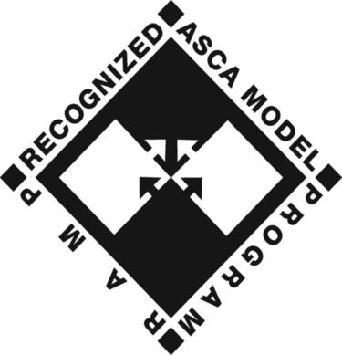
A Call for Change in School Counselor Preparation Programs
Professional school counselors need to move from the 3 “Cs” of counseling (i.e., counseling, consultation, and coordination) to a broader range of roles, including:
  Leadership
  Advocacy and systemic change
  Teaming and collaboration
  Counseling and coordination
  Assessment and use of data

Slide 29
Accountability: Practice That Demonstrates School Counseling Counts
To act as agents of school and community change, professional school counselors must:
  Articulate and provide a well-defined developmental counseling program with attention to equity, access, and support services.
  Routinely use data to analyze and improve access to, and success in, rigorous academic courses for underrepresented students.
  Actively monitor the progress of underrepresented students in rigorous courses and provide assistance or interventions when needed.
  Actively target and enroll underrepresented students into rigorous courses.
  Develop, coordinate, and initiate support systems designed to improve the learning success of students experiencing difficulty with rigorous academic programs.

Slide 30
Leadership and Transformed School Counselor Practice
In addition to having counseling skills, professional school counselors will need to:
  Expect all students to achieve at a high level.
  Actively work to remove barriers to learning.
  Teach students how to help themselves (e.g., organization, study and test-taking skills).
  Teach students and their families how to successfully manage the bureaucracy of the school system.
  Teach students and their families how to access support systems that encourage academic success.
  Use local, regional, and national data on disparities in resources and academic achievement to promote system change.
  Work collaboratively with all school personnel.

Slide 31
Leadership and Transformed School Counselor Practice
Professional school counselors will also need to:
  Offer staff development training for school personnel that promotes high expectations and high standards for all students.
  Use data as a tool to challenge the deleterious effects of low-level and unchallenging courses.
  Highlight accurate information that negates myths about who can and cannot achieve success in rigorous courses.
  Organize community activities to promote supportive structures for high standards for all students.
  Help parents and the community organize efforts to work with schools to institute and support high standards for all children.
  Work as resource brokers within the community to identify all available resources to help students succeed.

Slide 32
What Prevents Professional School Counselors from Changing?
Obstacles to changing the way professional school counselors practice include:
  An unwillingness to change resulting in maintenance of the status quo.
  Administrative practices dictating the role of professional school counselors.
  Counselors accepting responsibilities that are not part of their counseling role and function.
  Pressure from special-interest groups dictating their role.
  Many counselor educators have little or no ongoing involvement with K–12 institutions (including follow-up with recent graduates).
  Special education mandates for assessment, documentation, and ongoing services take too much of the counselor’s time.

Slide 33
What Prevents Professional School Counselors from Changing?
Additional obstacles include:
  Large numbers of practicing professional school counselors are functioning as highly paid clerical staff and/or quasi administrators.
  Professional school counselors sometimes function as inadequately trained therapeutic mental health providers with unmanageable client loads.
  The role is frequently determined by others.
  Little or no professional development is provided.

Slide 34
What Prevents Professional School Counselors from Changing?
Additional Obstacles:
  Crisis management on a day-to-day basis usurps too much of the professional school counselor’s time.
  Counselors may choose not to be involved in school reform efforts in school buildings.
  Counselors may not see academic achievement as their goal or mission.
  Professional school counselors generally work to change the student, not the system in which the student functions.

Slide 35
A Sense of Urgency is Propelling Change
The sense of urgency to help all students be successful in school is propelling professional school counselors to change.
Many professional school counselors are seizing the opportunity to be leaders in schools and work as advocates for students.
  School counselors are spearheading and successfully executing initiatives around improving schoolwide attendance rates, graduation rates, college-going rates, and access to and success in Advanced Placement and/or other college preparation courses for underserved student populations.

Slide 36
Summary
The work of school counselors today has been profoundly affected by forces that have driven all professionals in schools to change and/or ratchet up their contributions to raising student achievement, especially for students who have not had school success in the past.
School counseling, a critical working component of the system, is undergoing a transformation in which traditional inputs and processes are changing to support raising student achievement.
Professional school counselors will be valued when they demonstrate effectiveness in making systemic changes that allow all students access to rigorous academic programs and support for success.

