Slide 1
Chapter 4
Systemic, Data-Driven School Counseling Practice and Programming for Equity

Slide 2
New Vision
The new vision of school counseling is dedicated to social justice that intentionally increases the social and cultural capital for all students and aids in the attainment of equitable educational outcomes, especially for marginalized populations.
To be integral to the mission of schools, school counseling programs need to be systematic, data-driven, equity focused and able to produce measurable results.

Slide 3
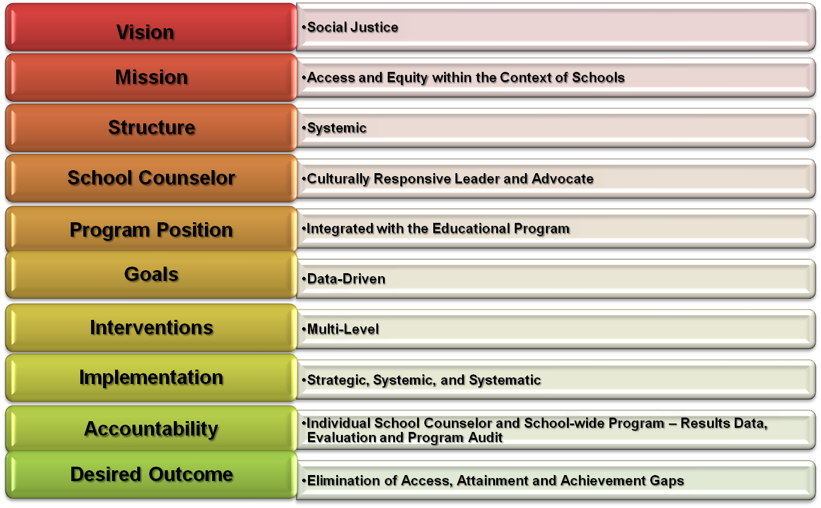

Slide 4
Commitment to Social Justice
A commitment to social justice and educational equity:
  Asks school counselors to know what they believe in and to courageously lead and advocate through intentional behavior in their daily work on behalf of students.
  Is embedded in the ASCA
  code of ethics.

Slide 5
Equity
Throughout the school counseling and educational literature there is a resounding call for “equity” in student outcomes.
Equity is the elimination of systemic barriers to create a culturally responsive school/district climate.
  In such a climate, policies and practices build social capital, shape high expectations and, ensure access to rigorous courses necessary for college readiness, extracurricular activities and other educational experiences.
  The results of equity are measured by participation and performance outcomes that show minimal variance due to race, income, language, gender or other demographic variables.

Slide 6
Program Structure
Changing deeply grounded inequities requires intentionally systems-focused programs that reach deep into and across the inner workings of the system and populations of a school district and each individual school.
  It requires a school system to be grounded in the applied principles of systems theory.

Slide 7
Understanding Systems in Schools
Schools are systems.
A systemic focus is achieved by placing the individual at the center of the system and examining the relations between, and expectations of, larger subsystems that impact the individual (e.g., school, family, community).

Slide 8
Understanding the Role of Data
Data has become central to the work of school counselors.
Using data in a powerful and transformative way can only happen when those examining the data believe the inequities revealed are unacceptable.
  The struggle to respond to data without blaming students and their families, using excuses that maintain stereotypes, and resistance still remains a challenge in some school counseling programs.

Slide 9
Data Skills
The first step in using data is to master the basics of data usage.
Data skills allow the school counselor to reach into the past and present of a school and plan for the future.

Slide 10
Data Skills
School counselors should know how to:
  Establish baseline data
  Identify data elements most relevant to a given topic
  Disaggregate data by different variables
  Cross-tabulate data to identify inequity
  Use data to develop goals
  Translate data goals into interventions
  Use data to drive strategic planning
  Use longitudinal data to create benchmarks and monitor student and goal attainment
  Collect outcome data
  Request appropriate data formatted for ease of use
  Compare school data to district, state, and national data
  Prepare and present data accountability reports to stakeholders

Slide 11
Access Data
Access is about opening doors to equitable engagement in the educational process for equitable outcomes.
Without access, students who have traditionally not been equitably served by the educational system do not even have the chance to achieve at higher levels.
Non-data elements of access: school counselor belief systems and school policies, practices, and procedures.
Data elements of access include: course enrollment patterns, student participation in extracurricular and enrichment activities, and the presence of highly qualified teachers.

Slide 12
Attainment Data
Attainment data measures rates of completion, specifically the rate at which a behavior, event, or marker point is reached or completed.
The term “achievement gap” is often used to refer to gaps that are actually about attainment.
Data elements of attainment: completion rates, graduation rates, college going rates, and attendance rates.

Slide 13
Achievement Data
Achievement data are primarily about scores (i.e., hard numbers that indicate a test, class, or exam score or grade).
Access, attainment, and achievement data elements are all intertwined.
  To work toward equity in outcomes for students requires that all three gap categories and their corresponding data elements be addressed.

Slide 14
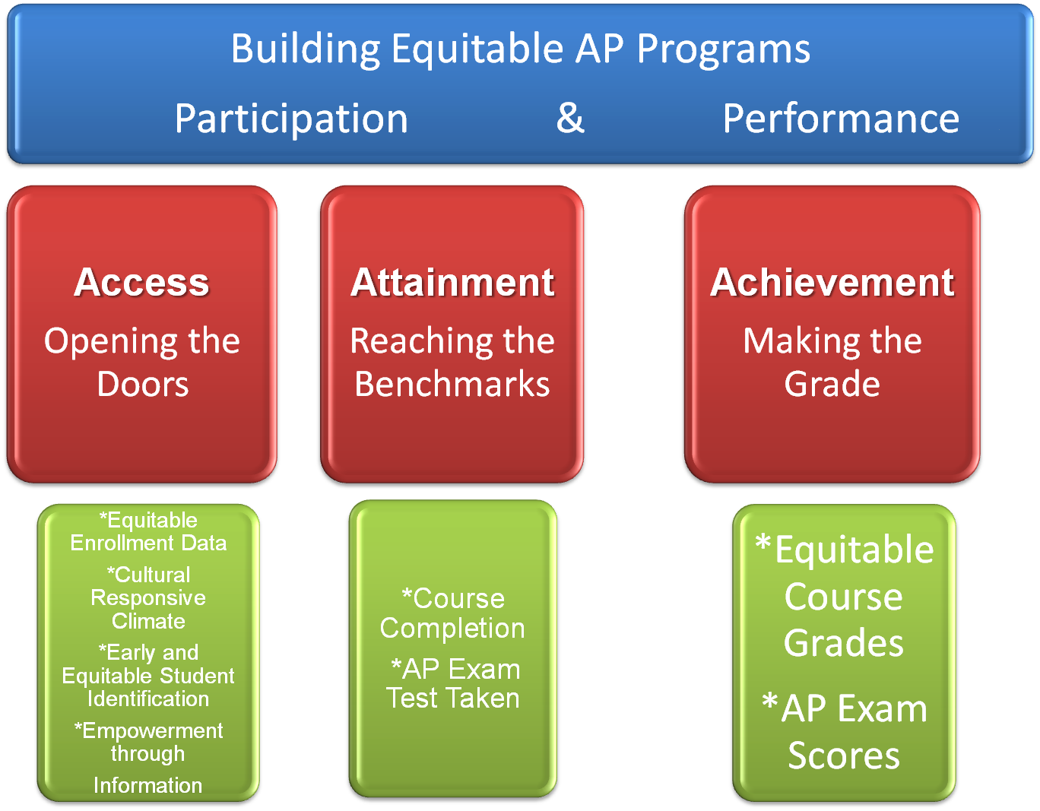

Slide 15
Theoretical Foundations
The theoretical foundation for school counseling programs is rooted in developmental psychology, educational philosophy, and counseling methodology, which provides a holistic foundation for the academic, career, and personal/social development of all students.
It is essential for school counselors and other members of the school community to possess an understanding of the diverse ways in which development is contextualized and expressed during the K-12 educational experience.

Slide 16
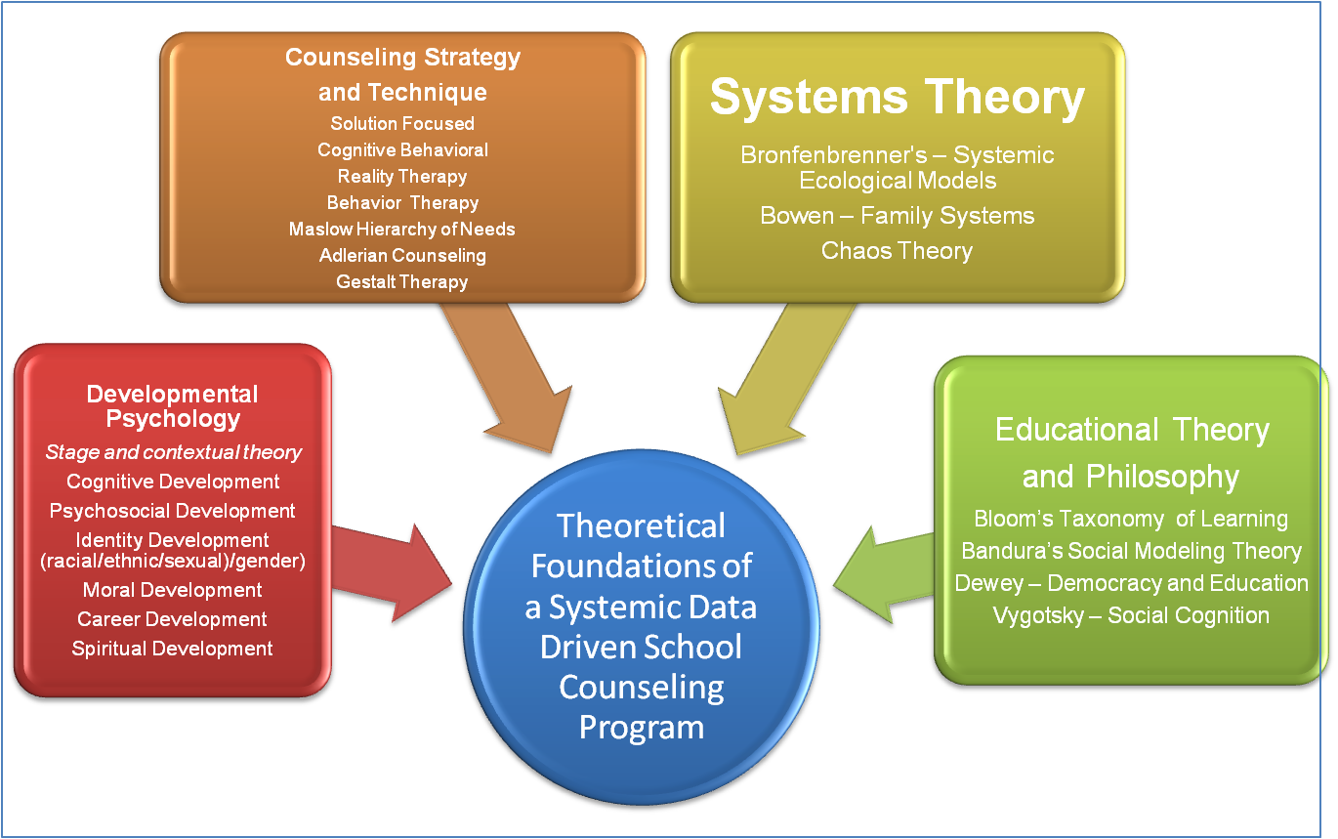

Slide 17

Systemic Assessment
Theory assists in identifying which data elements are most critical at a given developmental level in a given context. Provide guidance about the range of expected growth and development in sensitive and culturally responsive ways that respect a wide range of diversities.
Accountability
Theory can assist in the accountability process by offering one of the backdrops against which outcomes are measured for growth and development, the learning process, and systemic and equitable coverage within the cultural context of the school.
Vision and Mission
Theory assist in setting a mental model of successful growth and development from a holistic perspective that considers the past and present and points to an optimal future as a life long learner.
Goals
Theory assists in shaping rigorous goals that have relevant and feasible parameters for growth and development in the educational experience
Implementation
Theory helps influence content, tone, strategies, information, perspectives, and worldview to facilitate understanding, and, impart knowledge and skill that assist in equitable goal attainment

Slide 18
Theoretical Foundations
In a systematic data-driven school counseling program, it is critical for professional school counselors to possess an understanding of:
  Growth and development in children
  Abraham Maslow’s humanistic theory of development
  The educational philosophy of such luminaries as Dewey (1910) and Vygotsky (1978)
  The theory of Bloom’s Taxonomy of Learning (1956)
    Understand how higher order thinking skills are translated into curriculum so they can identify and promote it.

Slide 19
Lee, V. V. , 2005
Abraham Maslow’s Hierarchy of Needs
Actualization Needs
Elimination of Disparities
Equitable preparation for postsecondary
education and endeavors
-----------------
Competency Needs
Equity in Access, Achievement and
Attainment for ALL students
-------------------------------------
Belonging Needs
Culturally responsive school structures, policies, practices
and belief systems that validate individual and group identities, worth and dignity
as well as equitably develop the social and cultural capital of ALL
-------------------------------------------------------
Safety Needs
Physically, emotionally, intellectually and spiritually safe regardless of race, ethnicity,
economic status, gender, religion, sexual orientation, nationality, language or disability
-------------------------------------------------------------------------
Physiological Needs
Systemically met through school and community brokering of services; identification of those needing FARM or other social and systemic assistance
Notes:
19
If needs were met for all students it might look something like this.

Slide 20
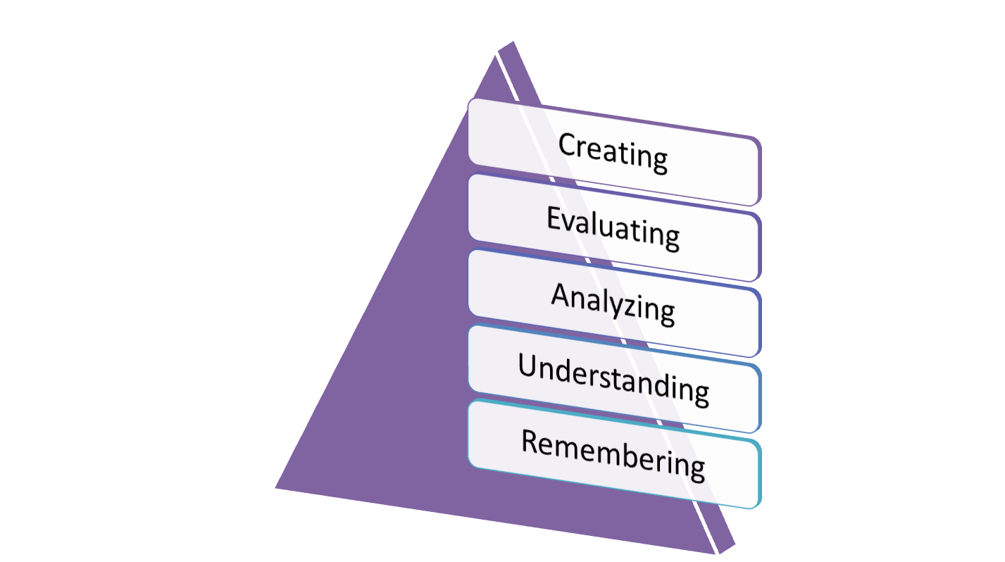
Taxonomy of Learning

Slide 21
Theory into Practice
All competencies used in a school counseling program should be able to be back mapped to theory.

Slide 22
Mission of the Program
A school’s or district’s mission statement provides the foundation for the school counseling program and states the collective results desired for all students.
There are a variety of ways mission statements are written; however, the most critical point is that it sets the foundation for the program to serve all students.
The development of the school counseling mission statement is one of the collaborative team initiative of a school counseling advisory team.

Slide 23
Systemic Assessment
Systemic assessments identify the needs of students and the larger school community by reaching every subsystem of the school community to ensure that the needs of all diverse populations are included.
Methods of collecting information include:
  School and district databases
  Adequate Yearly Progress reports
  Surveys
  Focus groups
  Interviews
  Observations
By examining various data elements, professional school counselors can understand what influences access, attainment, and achievement.

Slide 24
Goals
National Goals
  Provide key mandates such as closing access, attainment and achievement gaps, and ensuring safe and drug free schools.
State
  Consider national goals and add issues specific to their states.
School Districts
  Adapt state goals to specific needs of their districts.
Individual Schools
  Add additional goals to meet the needs of the students they serve.
By being systemic and data-driven, school counseling programs link to the goals of education and the mission of schools at the national, state, district and building level.

Slide 25
Goals of the School Counseling Program
Professional school counselors apply the data collected from the systemic assessment to create specific goals for their program.
Goals:
  Are developed as general statements of a desired outcome based on the data.
  Give direction to the program while allowing flexibility and creativity in implementation.
  Need to be written so that the results can be linked to other school-wide measures of student achievement and produce concrete measures.
  Can be prioritized to reflect the most intense needs of the school community.
  Reflect wider concerns, such as the AYP status of the school.

Slide 26
Program Integration
The educational success of all students is a school community moral obligation and, therefore, part of the ethical and professional responsibility of all school personnel.
The systemic data-driven school counseling program is integrated into the mission of schools by aligning program goals, development, implementation, and evaluation with the educational program.
Integration of the school counseling program with the educational program has the advantage of also integrating the school counseling program into school improvement plans and initiatives.
For successful integration that truly supports the educational program, professional school counselors need to be familiar with the academic goals and standards of their district and state and any other established curriculum that is used in the school.

Slide 27
Vision for Student Outcomes
District Level
Educational Program
Mission
District Level
Educational Program
Data-Driven Goals
District Level
Systemic Assessment
to Gather K- 16 Data
District Level
School Counseling Program Mission
District Level
School Counseling Program
Data-Driven Goals
Aligning Building Level Programs with District Mission and Data-Driven Goals
Elementary, Middle and Secondary
Building Level
Developmentally Focused Educational Program Mission
Building Level
Educational Program
Data-Driven Goals
Integration with District Level Mission and Goals
Building Level Systemic Assessment to Gather Context Specific Data
Building Level
Developmentally Focused School Counseling Program Mission
Building Level
School Counseling Program
Data-Driven Goals
School Counseling Program Intervention and Implementation Individual School Counselor Performance

Slide 28
Structure/Delivery
Schools are systems in which standards-based educational programs are delivered across the entire school community using multi-level initiatives.
School counseling programs need to have a structure/delivery process that mirrors system-level reality.

Slide 29
Delivery – Implementation at Multiple Levels
Levels of intervention
  Individual
  Group
  Classroom
  Grade-level
  School-wide
  District
  Home/family
  Community/society

Slide 30
Community
District
Classroom
Group
Individual
Grade Level
School Wide
Family

Slide 31
Delivery – Implementation at Multiple Levels
To deliver a program effectively, professional school counselors must possess the knowledge and skills to implement services in all levels of intervention so that program delivery is rigorous at all levels and is not compromised by limited professional school counselor knowledge or skill.
This broader delivery of school counseling services exemplifies the systemic nature of the school counseling program.

Slide 32
Outcomes/Results
A school counseling program that aligns with reporting categories of the educational program provides a ready-made data base to assist in conceptualizing and responding to the link between the educational program and the school counseling program.
This linkage forms a collaborative and systemic integration in the accountability and results of both programs.

Slide 33
Vision: Social Justice
Mission: Access and Equity
Program: Data Driven
Systemic
assessment
to collect data
Develop Goals
Strategically
prioritize goals to
align with the
mission of schools
Interventions
integrated with
the educational
program
Systemic
Implementation
through multiple
levels of
programmatic
intervention
Results data
collected
Analyze and present
data for program
evaluation
and audit
Program
revisions
as needed
What strategies and/or
implementation plan needs to be revised to meet the desired goals?
Data analysis to clarify needs: Graduation data reveals inequity among student groups.
1.
Demonstrate
concrete measures
of accountability
and goals not met:
What is the rate of
graduation after the
interventions?
8.
2.
All students will
graduate
7.
3.
Create a one, three
and five year plan
focused on
graduation that
involves all stakeholders
Collect data at
all levels of
programmatic
intervention
6.
4.
Implement interventions at the
community, school-wide, grade-level, classroom, group, and individual levels that are intentionally interrelated
and interdependent
Identify, align with, and support
and enhance initiatives in the
educational program that focus on
the achievement, attitudes and beliefs
necessary for graduation among all
members of the school community
5.
(Lee & Goodnough, 2005)

Slide 34
Ethical and Legal Directives
Practicing ethically and legally guides the implementation of a systemic data-driven school counseling program.
Federal, state, and district mandates as well as standards from professional organizations guide the development, implementation, and evaluation of the school counseling program.
By appropriately implementing ethical and legal directives and practicing within these guidelines, the professional school counselor and the program interventions equitably serve all students and promote the overall educational mission of the school.

Slide 35
District and School Policies
Policies:
  Create a “way of doing things”
  Set the tone for the culture and climate of the school
  Operationalize ethical and legal mandates
  Help to implement goals
The practices and procedures used to implement policy can either advantage or disadvantage all students or specific groups of students.
District and school policies interface with the mission, goals, development, implementation, and evaluation of the systemic data-driven school counseling program.
Professional school counselors can be leaders and advocates who examine the impact of day-to-day interpretation and application of school policy.

Slide 36
Planning the School Counseling Program
Strategic planning begins with the vision, mission, data, and subsequent goals of the program.
Creation of a calendar for the school counseling program is an essential tool that demonstrates the systemic nature of the program and organizes interventions into an intentional order.

Slide 37
Outline of Activities for a School Counseling Calendar
Ongoing Activities
  Team/IEP meetings
Group Level
  Groups that are beginning, continuing, or ending this month
Classroom
  Targeted interventions with classrooms in need
Grade-level
  Grade-specific interventions
School-wide
  Data collection, analysis, presentation
Family Level
  Parent/Guardian groups
  Information/skill building workshops
Community Level
  Community advisory boards
  Task for equity
Professional Development
  Conferences
  In-house trainings
Upcoming Events
  List of activities that need to be accomplished to ensure timely and thorough planning for each intervention.

Slide 38
Individual
This level of intervention is used to respond to crisis situations and issues particular to specific individual students.
Issues identified at this level provide insight into issues in the larger school that can then be further examined using specific data elements.
Issues at the individual level involve school-wide policies such as: confidentiality, informed consent, duty to warn, and parent/guardian permissions for counseling.

Slide 39
Group
This level of intervention responds to specific and targeted needs across all grade levels.
Group is a critical level of intervention because it provides social modeling, peer support, and learning through a developmentally appropriate forum.
Because this level of intervention serves only a small population of students, it should be intentionally interrelated to corresponding services at other levels.

Slide 40
Classroom
Collaborative classroom instruction can be offered in one particular class or across several classes in the school.
Data is used to identify classrooms and teachers in need of specific assistance to transform the culture and climate of the learning environment.

Slide 41
Grade Level
This level of intervention attends to the context of grade-level experiences and transitions at developmental benchmarks.
Emphasis on examining policies that impact specific grade levels is essential.
The ability to analyze and use disaggregated data helps the professional school counselor discern the influence of grade level and transition points on students.
Examples of interventions include: transition activities, post secondary planning, resume writing, and the scholarship process.

Slide 42
School-wide
The school-wide level of intervention has the greatest potential for removing systemic barriers and creating the conditions for learning at all other levels.
The potential of this level of intervention lies in examining the interrelatedness and interdependence of all school populations and the corresponding school-wide disaggregated data.
Interventions reflect areas of growth and development that are important to the entire school and focus on issues such as culture and climate.

Slide 43
District
This level of intervention is focused on connecting the work of school counselors to the larger district in ways that respond to both vertical and lateral district wide issues and increase the equitable outcomes for students.
District wide strategic interventions that pool the skill and resources of counselors in both vertical and horizontal teaming and collaboration can maximize time and efficiency and provide a broader perspective on the needs of students.
To work effectively at this level the school counselor must possess an understanding of the interrelationship between the needs of elementary, middle and high school students and factors that impact healthy growth and development as well as a basic understanding of the functioning of schools at other levels.

Slide 44
Family
Interventions at this level assist parents and guardians in learning skills to successfully navigate school and community services to gain access to resources for their children and assist their children in mastering the skills necessary for educational success.
Intentional and culturally responsive outreach to marginalized parent/guardian populations can promote increased engagement of their children in the educational process and thus result in greater equity.

Slide 45
Community
This level of intervention is used to actively involve all community stakeholders in creating broad-based partnerships for student success.
Community involvement can increase the likelihood that students will experience consistent expectations across the multiple contexts of their lives.
Careful planning, documentation, timely and clear communication, and shared decision making are essential.
Using data creates urgency and drives decisions; using inquiry helps to focus, evaluate, and revise interventions.

Slide 46
Community
Administrative support and sanctioning (preferably codified in policy) of the collaborative efforts of the professional school counselor and program interventions can help prevent school counseling from becoming marginalized and superfluous to the mission of schools.

Slide 47
Evaluating the Systemic Data-driven School Counseling Program
Evaluating a systemic data-driven school counseling program serves several purposes:
  Demonstrates accountability and establishes the credibility of professional school counselors and the school counseling program.
  Demonstrates that established goals were met and allows counselors to assess the impact of the program and the levels of programmatic interventions that were most successful.
  Demonstrates where goals were not met, revealing the need for further examination.
  Demonstrates how the school counseling program contributes to the achievement of AYP, district, state, and national goals for the equitable achievement of all students.

Slide 48
Implications for Professional School Counselors
Creating systemic data-driven school counseling programs is the ethical responsibility of all professional school counselors in order to meet the needs of all students.
Professional school counselors must:
  Be self-reflective practitioners
  Be able to assess and evaluate their own skill base
  Develop and implement an ongoing professional development plan that will allow them to remain relevant
Such commitment ensures professional school counselors will develop the competence to implement the systemic data-driven programs that equitably meet the needs of all students.

Slide 49

Building Level
Educational Program
Data-Driven Goals
School Counseling Program Interventions and Implementation
Individual School Counselor Performance
Building Level
School Counseling Program
Data-Driven Goals
Individual
Group
School Counselor Culturally Responsive Practice Delivering Equitable Service at all Levels of Programmatic Intervention
Classroom
Grade level
School-wide
District
Family
Community
Results Data Program Evaluation
Performance Evaluation for individual school counselor
School Counseling Program and Individual School Counselor Accountability
When Accountability is met the
The Access, Attainment and Achievement Gaps can be Eliminated

Slide 50
Summary/Conclusion
This chapter has offered a rationale, description, and tools useful in creating a systemic data-driven school counseling program.
  To build this type of program, professional school counselors need to possess the values, attitudes, and beliefs implicit in the transformed role of the professional school counselor.
The implementation of systemic data-driven school counseling programs can form the bedrock from which the needs of all students are equitably met in a learning environment that encourages academic success with cultural integrity.

