Slide 1
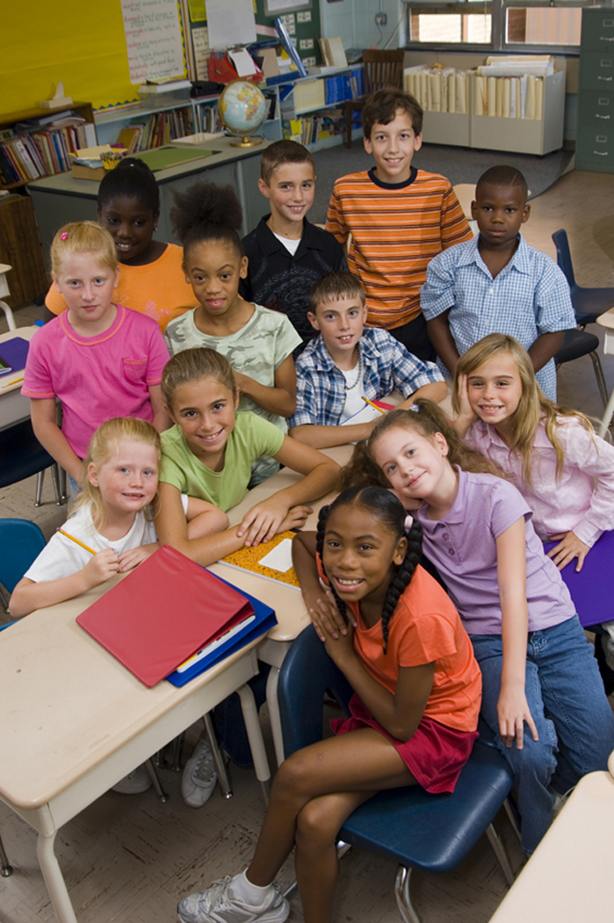
Multiculturally Competent School Counselors: Affirming Diversity by Challenging Oppression
CHAPTER 8

Slide 2
Introduction
Based on the US’s rapidly changing demographics, multiculturalism, as a key component of the school counseling profession, is no longer viewed as just desirable, but mandatory.
It is not clear whether professional school counselors are effective in their work with students from oppressed backgrounds.
Some research has suggested that professional school counselors maintain a status quo of educational outcomes for minority students.

Slide 3
Cross/ Multicultural Counseling
The facilitation of human development through the understanding and appreciation of cultural diversities.
ASCA recognizes cultural diversities as important factors deserving increased awareness and understanding on the part of all school personnel, especially the professional school counselor.

Slide 4
According to the 2010 revision of the ASCA Ethical Standards for School Counselors, a professional school counselor:
Monitor and expand personal multicultural and social justice advocacy awareness, knowledge, and skills
Develop competencies in how prejudice, power and various forms of oppression affect self, students and all stakeholders
Acquire educational, consultation and training experiences to improve awareness, knowledge, skills and effectiveness in working with diverse populations
Affirm the multiple cultural and linguistic identities of every student and all stakeholders
Use inclusive and culturally responsible language in all forms of communication
Provide regular workshops and written/digital information to families to increase communication between families and the school to promote increased student achievement
Work as advocates and leaders in the school to create equity-based school counseling programs that help close any achievement, opportunity, and attainment gaps that deny all students the chance to pursue their educational goals

Slide 5
Multicultural and Anti-Oppression Terminology
Culture is defined in a variety of ways:
(1) the ways in which people perceive their experiences of the world so as to give it structure;
(2) the beliefs by which people explain events;
(3) a set of principles for dealing with people as well as for accomplishing particular ends; and
(4) people’s value systems for establishing purposes and for keeping themselves purposefully oriented.

Slide 6
Race
Race is a term that has been defined in various ways:
Behavioral scientists explain that race has been used to denote genotypically homogeneous human groupings (Kluckhohn, 1985).
Baba and Darga (1981), indicate that defining race through the practice of racial classification by biological characteristics is practically impossible.
In counseling and psychology, race has been used in three main ways:
(a) differential sociopolitical and economic socialization;
(b) biogenetic psychological characteristics inferred from the presence of observable “signs” commonly assumed to be racial; and
(c) differential cultural (e.g., values, beliefs, rituals) socialization (Helms, 1996).

Slide 7
Race
Professional school counselors must remember that race has been used in schools to carry out:
segregation,
stereotyping groups of students’ academic achievement,
tracking,
selection of students for special education, and
lowering teacher expectations for ethnic minority students.

Slide 8
Ethnicity
Defined by Schaefer (1990, p. 27) as “a group set apart from others because of its national origin or distinctive cultural patterns.”
It is within this ethnic identity that an individual is socialized to take on the group’s values, beliefs, and behaviors.
McGoldrick and Giordano (1996) referred to ethnicity as: “A common ancestry through which individuals have evolved shared values and customs. It is deeply tied to the family, through which it is transmitted. ...The concept of a group’s “peoplehood” is based on a combination of race, religion, and cultural history and is retained, whether or not members realize their commonalities with one another. The consciousness of ethnic identity varies greatly within groups and from one group to another.” (pp. 1–2)

Slide 9
Oppression
Oppression can be defined in an equation: Oppression = prejudice x power.
Maintaining incorrect conscious or unconscious attitudes, feelings, and beliefs about members of a cultural group as inferior or about that group’s cultural differences is unacceptable.
Young (1990) further expanded the definition of oppression by delineating five conditions of an oppressed group: exploitation, marginalization, powerlessness, cultural imperialism, and violence.
Other forms of oppression: individual, cultural, systemic, internalized, and externalized oppression.

Slide 10
Oppression
Professional school counselors can find evidence of oppression in K-12 school data.
Achievement gaps are the differences in academic performance among groups of K-12 students based on ethnicity/race, gender, social class, disability status, language status, and other variables.
Opportunity gaps are the differences in resources given to K-12 students.
Attainment gaps are the differences among groups who attain particular status in schools (e.g., graduation, college admission) based on data disaggregated by ethnicity/race, gender, etc.

Slide 11
Multicultural and Social Justice Counseling
Definitions:
Locke (1990) referred to multicultural counseling as a counseling relationship in which the counselor and client differ as a result of socialization in unique cultural, racial or ethnic environments.
Vontress (1988) noted that if the counselor and client perceive themselves as culturally similar, even if the opposite is true, then it should not be considered cross-cultural counseling.
CACREP: Views multicultural counseling from a universal perspective and includes characteristics of not only race and ethnicity, but also gender, lifestyle, religion, sexual orientation, etc. (CACREP, 2009). CACREP’s definition further emphasizes the implication of a pluralistic philosophy.

Slide 12
Multicultural and Social Justice Counseling
More recently, the terms social justice counseling and social justice perspective have been used in the literature instead of multicultural counseling.
Social justice counseling addresses issues related to both individual and distributive justice.
It involves the promotion of equity, access, participation, and harmony.
Professional school counselors should shift to a more social justice perspective in order to challenge the achievement inequities found in many schools.

Slide 13
Multicultural Competence
Three main areas or dimensions:
Awareness: stresses the understanding of personal worldviews and how counselors are products of their own cultural conditioning.
Knowledge: reinforces the importance of understanding the worldviews of culturally different clients.
Skills: deals with the process of actively developing and practicing appropriate intervention strategies for culturally diverse clients.
Counselors must understand the client’s worldview and actively develop and practice appropriate intervention strategies needed for work with culturally different clients.

Slide 14
Multicultural Competence
S. Sue (1998) suggested that cultural competence consists of three characteristics:
Being scientifically minded
Having skills in dynamic sizing
Being proficient with a particular cultural group
When does one know he or she is multiculturally competent?
When a counselor possesses the necessary skills to work effectively with clients from different cultural backgrounds, and acknowledges client-counselor cultural differences and similarities are significant to the counseling process.

Slide 15
The Need for Culturally Competent Professional School Counselors
Need to close attainment, achievement, opportunity, and funding gaps among groups of students in K-12 schools.
Need to increase numbers of college bound students from various cultures.
Need to represent students of various cultures in Advanced Placement and accelerated courses.

Slide 16
Integrating Multicultural and Anti-oppression Topics in School Counseling Programs
Professional school counselors can play a pivotal role in combating oppression and assisting culturally diverse students achieve success, but must first realize the cross-cultural limits of traditional school counseling.
Most counselors lack specific training to deal with the problems and effects of oppression.
Professional school counselors must engage in interventions that create social environments for students that support social justice.
Social justice refers to equity, equality, and fairness in the distribution of societal resources (Flynn, 1995).

Slide 17
Empowerment-Focused Interventions
Empowerment: can be defined as a process of increasing personal, interpersonal, or political power so that individuals, families, and communities can take action to improve their situations.
It is multidimensional, social, and a process.
Can occur at different levels.
Similar to a path or journey.

Slide 18
Empowerment-Focused Interventions
Critical consciousness has been described as involving three psychological processes:
(1) group identification, which includes identifying areas of common experiences and concern with a particular group,
(2) group consciousness, which involves understanding the differential status of power of groups in society, and
(3) self- and collective efficacy, which is described as perceiving oneself as a subject (rather than object) of social processes and as capable of working to change the social order.

Slide 19
Empowerment-Focused Interventions
Professional school counselors can facilitate discussions about one’s group identification and help students understand how their group membership has affected their life circumstances.
Provide students with knowledge and skills to think critically about their problems and develop strategies to act on and change problems.
Help build on student strengths.

Slide 20
Individual Counseling
Since very few counseling approaches have been designed and validated for use with specific cultural groups, professional school counselors should use and develop individual counseling strategies that are effective with culturally diverse students.
Counselors must also be aware of the pervasive influence that culture has on the counseling process.
Be aware of the impact of culture on students' ways of thinking, belief systems, definitions of self, decision making, verbal and non-verbal behaviors, and time orientation, which all can have profound effects on behavior.

Slide 21
Group Counseling
Professional school counselors must be able to facilitate the cultural development of group members.
Counselors must remember students are socialized in a society in which some groups have a history of suffering stereotypes, prejudice, oppression, and discrimination.
When composing the group, take cultural differences into account, as well as how the group members will relate to each other and the leader.
Be familiar with the literature for selecting and planning culturally diverse groups.

Slide 22
Consultation
Be sensitive to the cultural differences between the three parties in the consultation process: consultant, consultee, and client.
Ensure that the teacher or parent understands that his/her input is welcomed and in many cases is necessary for the success of the intervention.
Do not forget that the student is the focus of the consultee's problem.
Focus on conceptualizing the problem or concern of the consultee within a cultural context.
Be able to identify and challenge a consultee's stereotypical beliefs and biases.

Slide 23
Assessment
Professional school counselors must understand the cultural appropriateness of assessment instruments used frequently in schools.
Be able to evaluate instruments for cultural bias and identify other methods for assessing culturally diverse students.
Be competent in relaying assessment results to culturally diverse students and parents.
Be cognizant of the presence of unjust assessment practices.
Be aware of the testing options for English language learners.

Slide 24
School Counseling Core Curriculum Lessons
Professional school counselors can help students become more culturally sensitive by implementing classroom school counseling curriculum lessons focused on:
affirming differences,
accurate multicultural terminology,
exploring one's biases,
learning about ethnic/racial identity development models,
understanding diverse world views, and
challenging the various oppressions.
Some suggested activities include:
giving students case studies of students dealing with racism,
discussing the dangers of stereotypes,
interviewing a friend or family member about his/her experience with prejudice,
inviting guest speakers from the community to discuss their personal ethnic/racial/cultural histories, and
having students do a family history on the oppression of their ancestors.

Slide 25
School Counseling Program Coordination
Be sensitive to the diverse needs of those persons inside the school and in the community.
Professional school counselors should coordinate school-wide programs relevant to the needs of all students, particularly those from culturally diverse backgrounds.
Take the time to meet and develop relationships with referral sources that are representative of their school's communities.
Be familiar with services offered both in ethnic/racial communities and in the larger community.

Slide 26
Data Collection and Sharing
Helps highly diverse schools "identify achievement gaps, address equity issues, determine the effectiveness of specific programs and courses of study, and target instructional improvement" (Lachat, 2002, p. 3).
Helps ensure every student receives the benefits of the school counseling program.
Must work with administrators, faculty and advisory council members to analyze data in order to create a current picture of students and the school environment.

Slide 27
Data Collection and Sharing
Professional school counselors monitor student progress through four types of data:
Achievement data, which measures students’ academic progress.
Attainment data, which measures those factors that the literature has shown to be correlated to academic achievement.
School culture data, which includes data regarding attendance, suspensions and expulsions, faculty-to-student relationships, school climate, student attitudes, and drop out rates.
Standards- and competency-related data, which measure student mastery of the competencies delineated in the ASCA National Model (2005).

Slide 28
Increasing School Counselor Multicultural Competence
Five ways in which professional school counselors can increase their level of multicultural competence:
Investigate personal cultural, racial, and ethnic heritage
Attend workshops, seminars, and conferences on multicultural and diversity issues
Join organizations that are focused on cultural and social justice equity competencies
Read literature written by culturally diverse authors
Become familiar with multicultural education literature

Slide 29
Case Studies
Another step in the process of developing multicultural counseling competence is for professional school counselors to openly question their thoughts and behaviors when working with ethnic minority students.
Professional school counselors can use case studies as a means to begin discussions with colleagues.

Slide 30
Summary/ Conclusions
Critical need to provide effective school counseling programs that offer both culturally competent and anti-oppressive programs
Must continue on the journey of developing multicultural competence in counseling
Acquire the knowledge and skills that will allow one to critically assess and intelligently address the various challenges encountered by students and their families.

